Slide 1
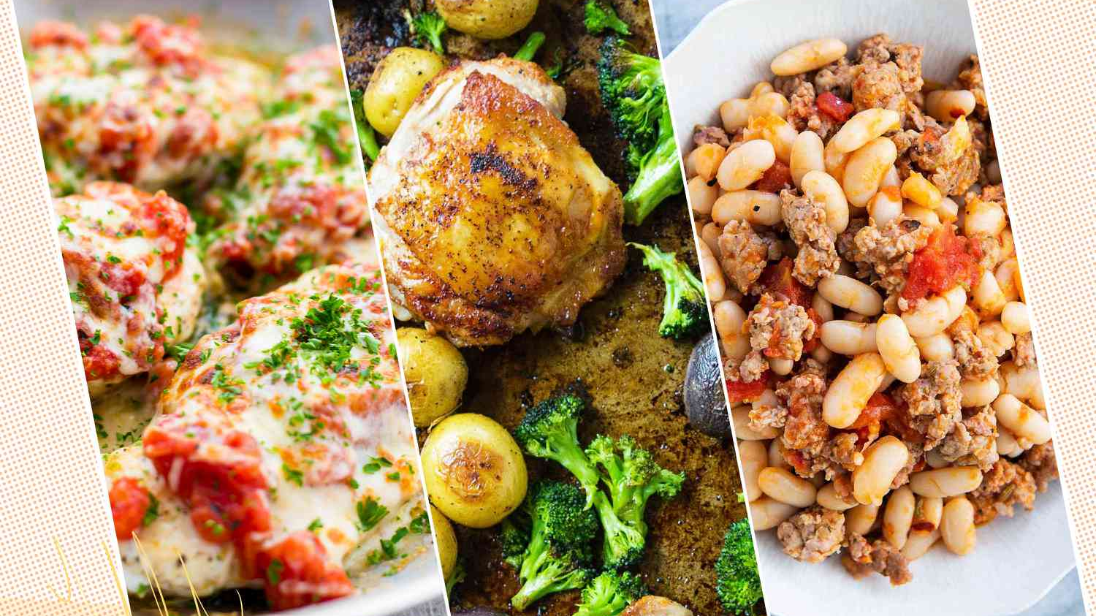
Northeastern University College of Engineering Department of Electrical and Computer Engineering Recipe Book
Eric Gu, Abigail Boleng, Yu-Hsiang Huang
EECE2140: Computing Fundamentals for Engineers

Slide 2
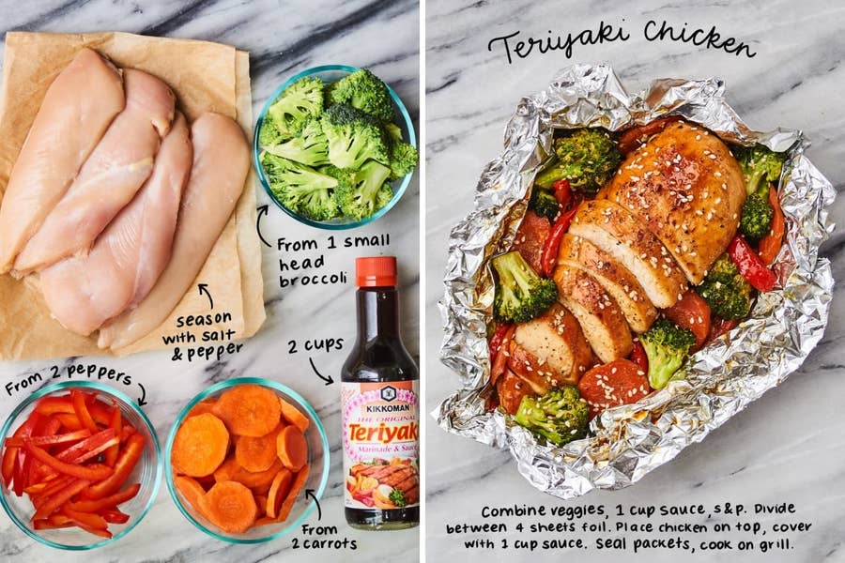
Introduction
Objectives:
Create a recipe book to be user personalized
Goals:
Enter recipe
Use keyword to search
Save all recipes to a text file
Project Scope
Bring a specialized experience to users that are interested in cooking and enjoy keep track of their recipes.
Bring convenience to people in their daily life by providing recipe options based on the ingredients they have at home.
Notes:
Eric

Slide 3
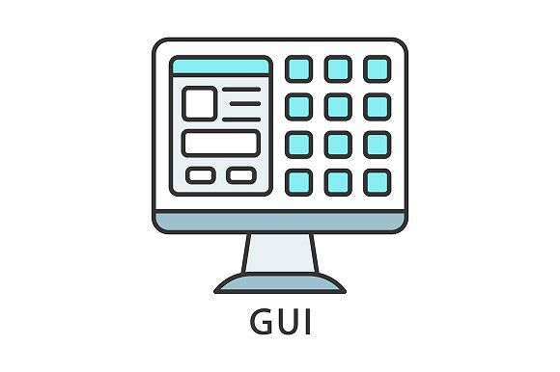
Literature Review
Previous Existing Work:
Inspiration from some videos when it came to the design of our GUI.
Guidance for Editing File & Reading Data from File
Pillow(PIL)
Relation to Previous Work [1] [2][3][4][5]
Notes:
Abigail
Pillow : recomded

Slide 4
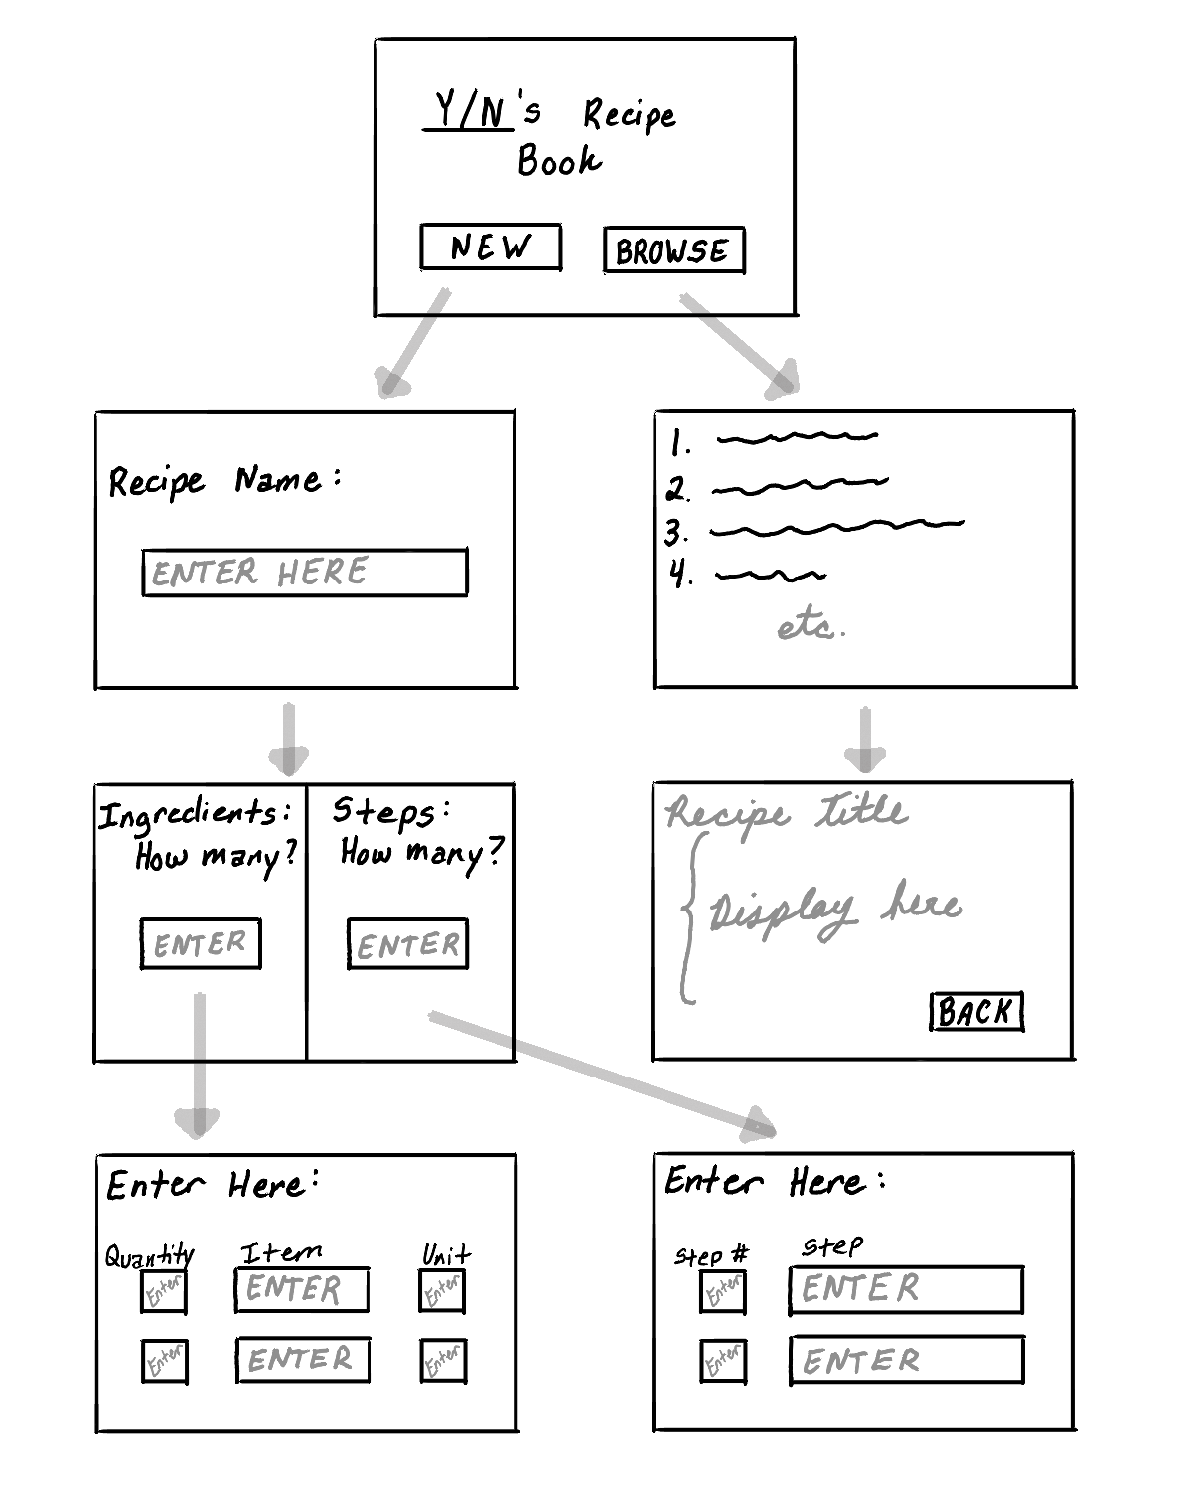
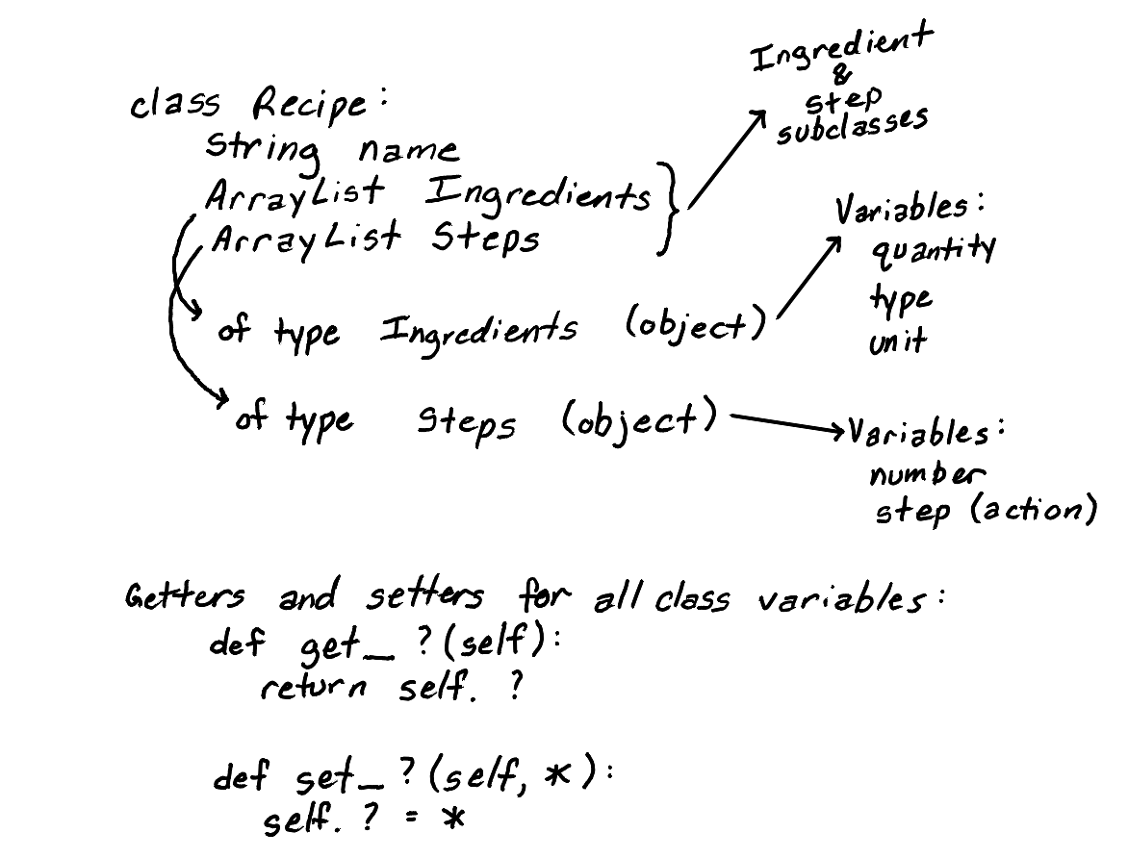
Original Outline
Notes:
Abigail

Slide 5
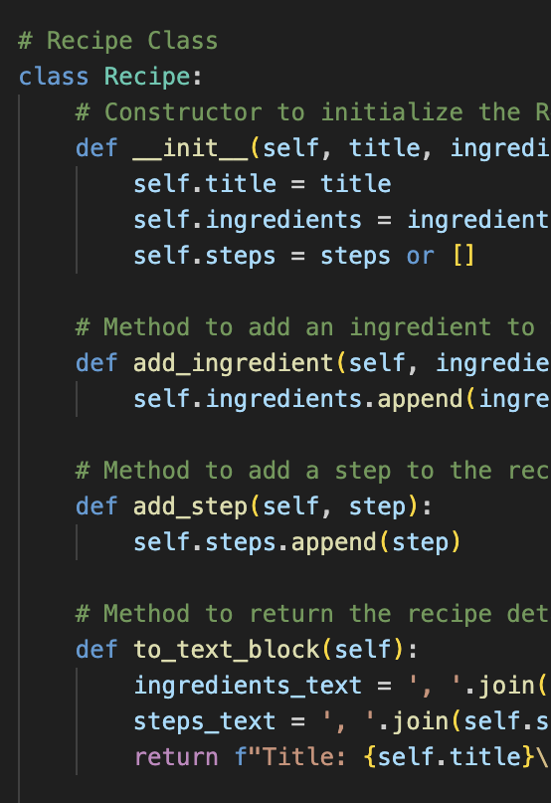
Methodology
Class Recipe
Step → String
Class Ingredients
Class Recipe Manager
Class GUI
Code/Libraries Used:
Python for backend logic.
Tkinter for GUI.
Pillow (PIL) for image handling.
Object-Oriented Programming (OOP)
Data Structures:
List
String
Integer
Notes:
Abi (with maybe help from Sean)
Relationship Between Classes:
Composition Relationship:
Recipe Class uses Ingredient Class:
The Recipe class has an attribute (self.ingredients) that stores a list of Ingredient objects.
This means that a Recipe is composed of Ingredient objects.
This is a has-a relationship (e.g., "A Recipe has Ingredients").
RecipeManager and RecipeApp Classes:
The RecipeManager class manages multiple Recipe objects.
The RecipeApp class is used to manage the GUI and interacts with the RecipeManager to manipulate Recipe objects
Interface Elements:
Tabs (Notebook Widget):
Search Recipe: Search by title or ingredients.
Add Recipe: Input recipe title, ingredients, and steps.
Manage Recipes: View, delete, sort, or edit existing recipes.
Image Support: Uses an image to enhance the Search tab.
Special Features:
Scrollable Recipe View: Displays all recipes in a scrollable frame.
Pop-up Windows: View or edit recipes in separate windows for better user experience

Slide 6
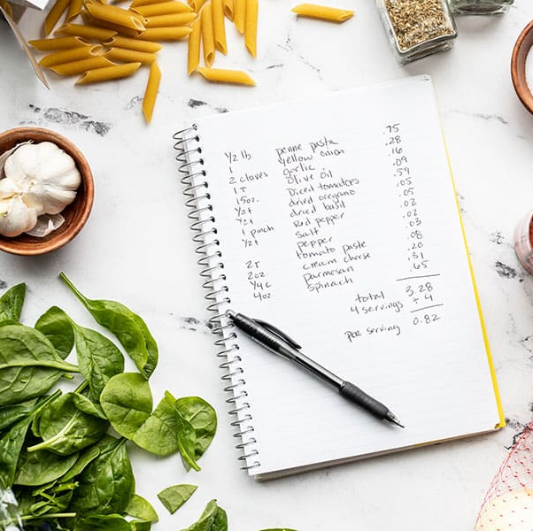
Results
As a group, we spent 6 hours per week since the project was assigned.
Recipes are entered and stored to text file.
Save and edit file.
Close out whole program and reopen with saved data.
Notes:
Eric

Slide 7
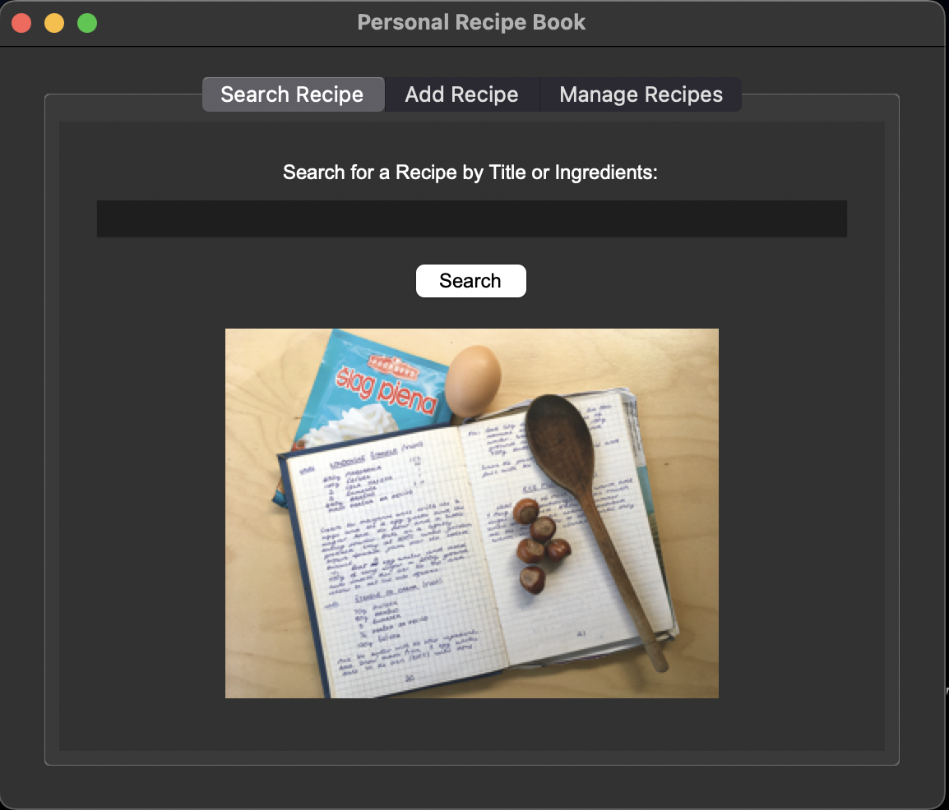
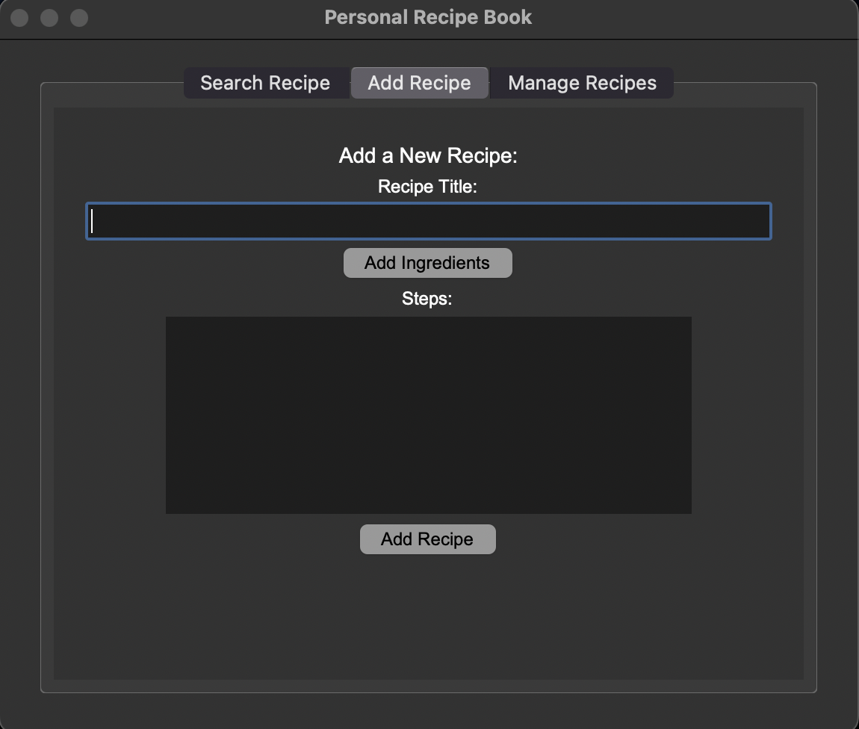
GUI
Notes:
Sean

Slide 8
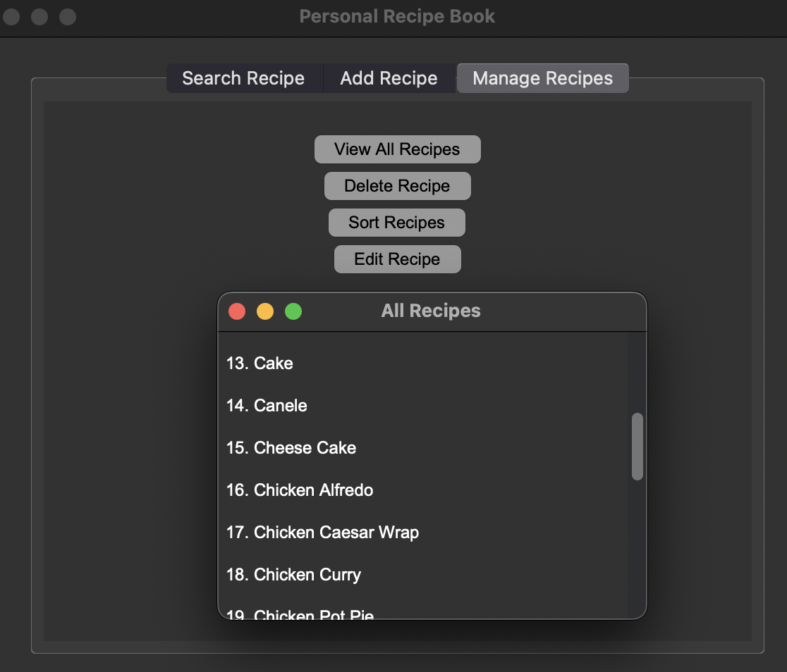
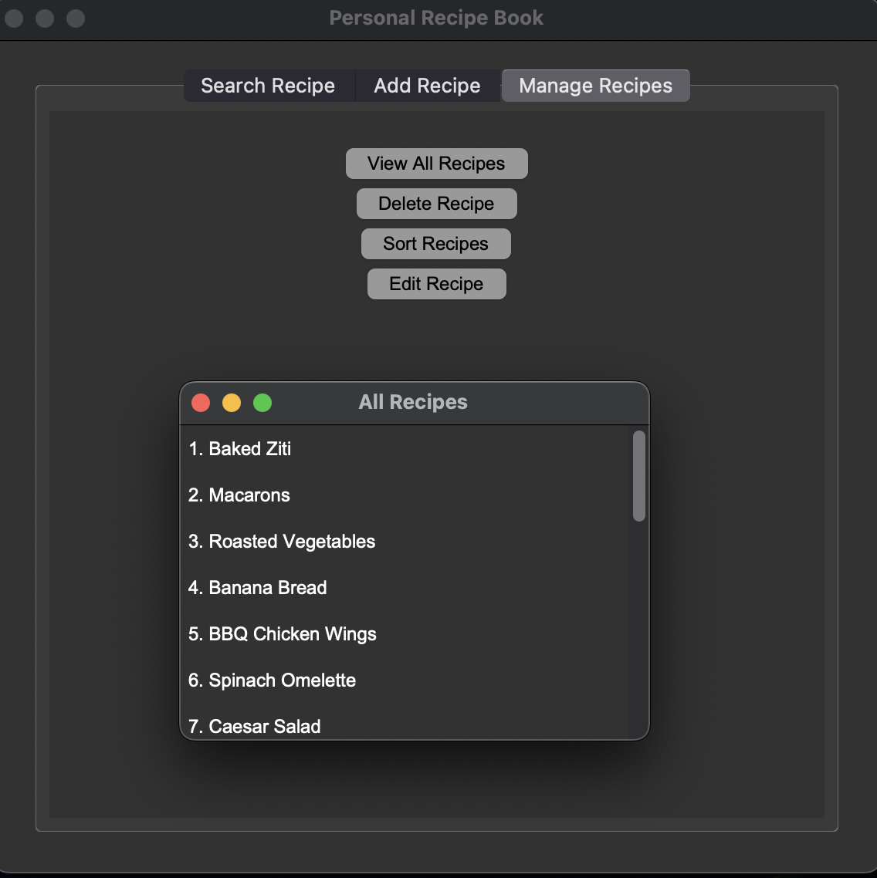
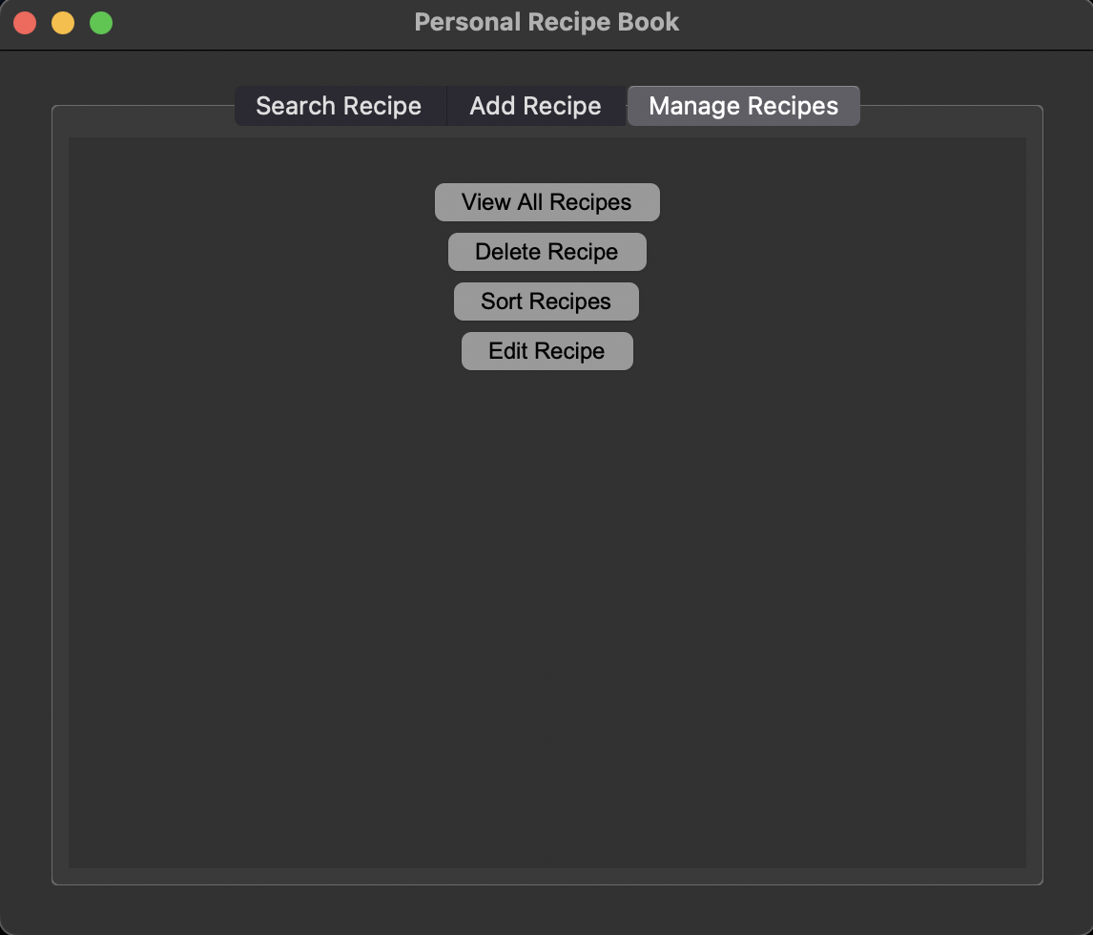
GUI
Notes:
Sean

Slide 9
Discussion
Recipes can be stored.
User’s life becomes productive through this personalized recipe book as they won’t waste time thinking about to make.
Limitations:
Time
User Compatibility
Our knowledge of GUI limits us from making the interface more technically complex.
Edit Recipe should allow users to enter more ingredients if needed and remove unneeded
Should apply Entry widgets for ingredient searches to allow users to select a specific recipe to view instead of showing multiple windows.
Alter cancel button into "previous step" button to return the user to the previous field to allow further edits
Allow users to add images to the recipe database
Notes:
Sean

Slide 10
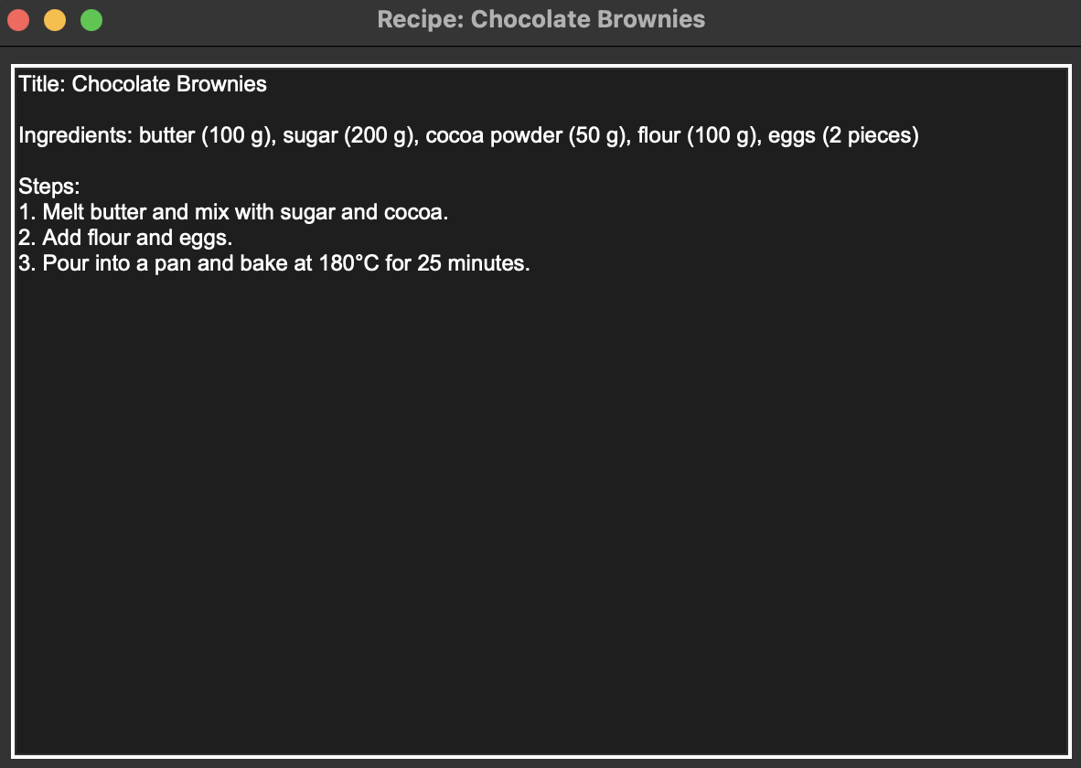
Conclusions
Create interface where user can enter recipes and store them for the future.
Edit and Delete Recipe
Sorting Recipes
Recommendations:
Add photos to interface relating to each different recipe
Let friends be able to connect through the software to share recipes.
Allow for upload of recipes in pdf form instead of manual entry
Notes:
Eric

Slide 11

References
[1] https://www.youtube.com/watch?v=ibf5cx221hk&ab_channel=NeuralNine
[2]
https://www.geeksforgeeks.org/scrollable-frames-in-tkinter/
[3] https://www.pythontutorial.net/tkinter/tkinter-photoimage/
[4]
https://www.w3schools.com/python/python_file_write.asp
[5] https://www.w3schools.com/python/python_ref_list.asp

Slide 12
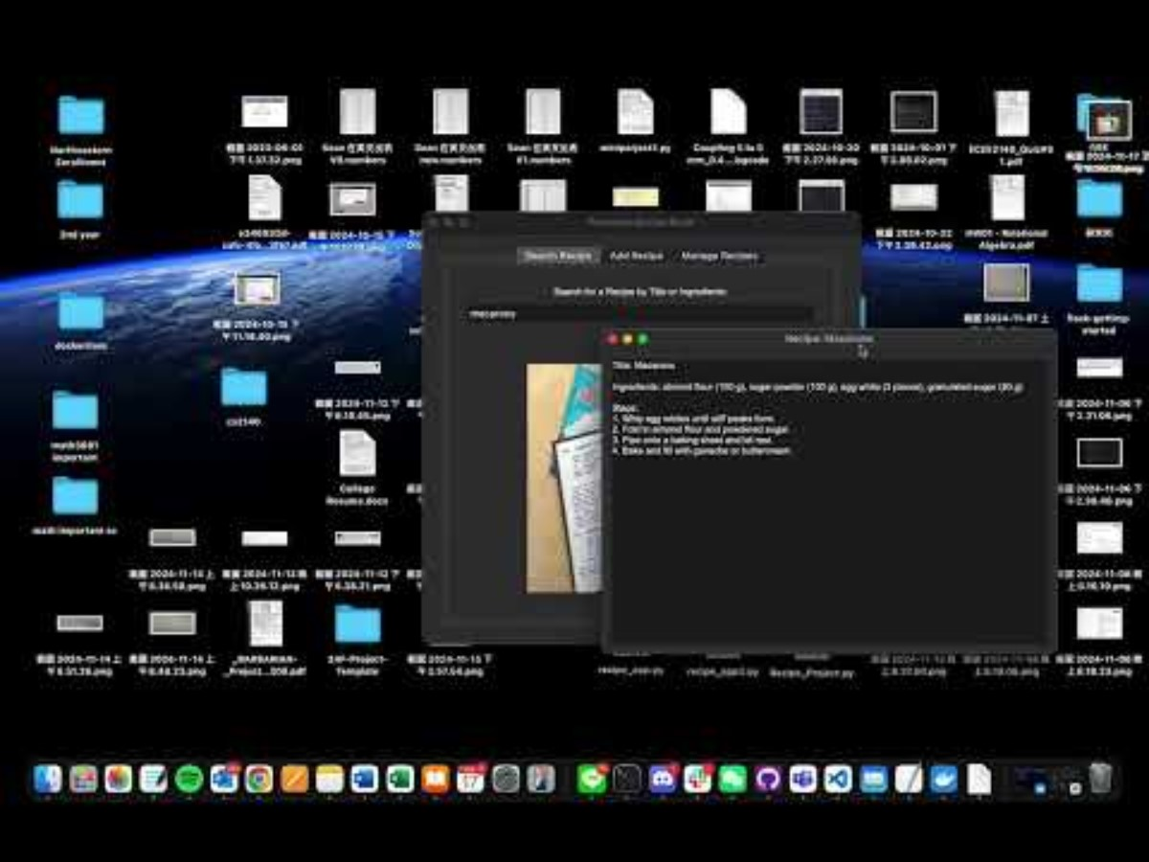
DEMO

